Slide 1
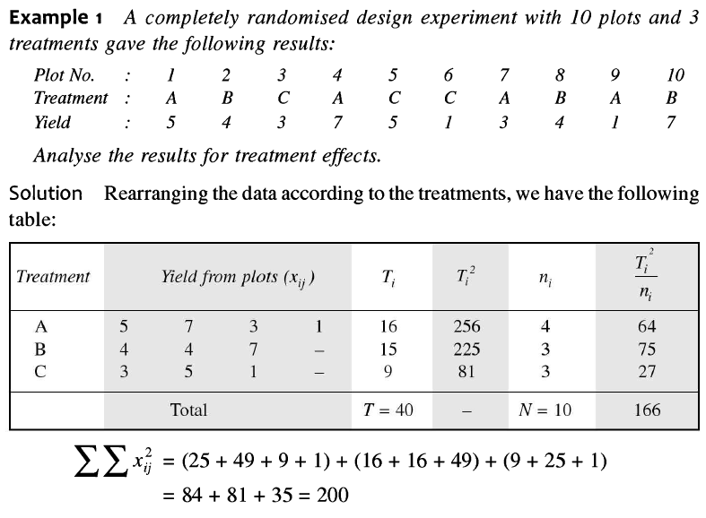

Slide 2
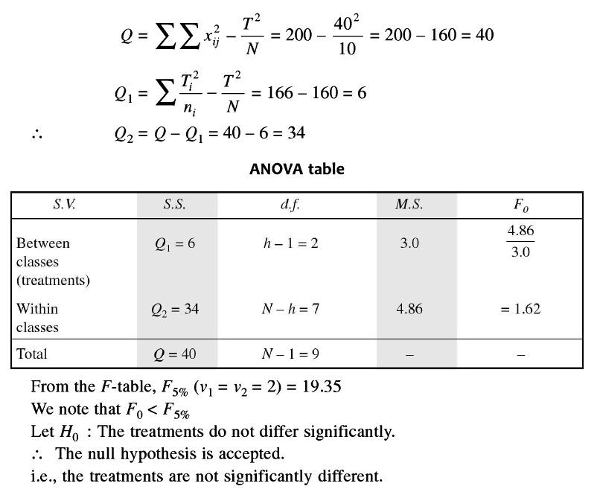
Note:
Q = SST
Q1 = SSC
Q2 = SSE

Slide 3
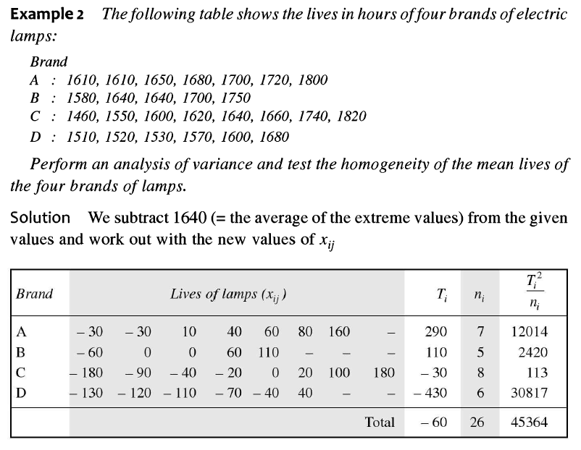

Slide 4
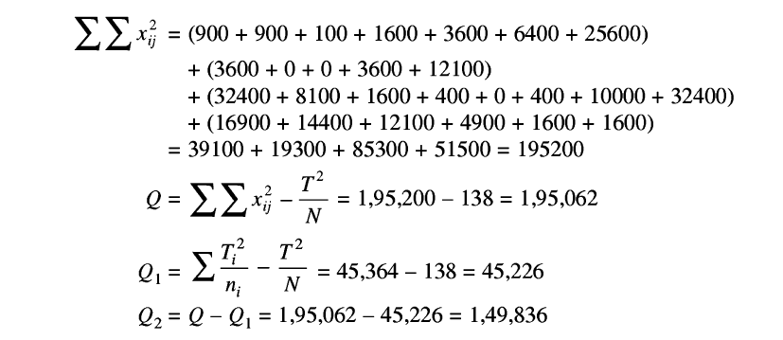
Note:
Q = SST
Q1 = SSC
Q2 = SSE

Slide 5
